Slide 1

Internship @ Micron
De Guzman Leif Nathan Sonido (232783Z)
Electronic & Computer Engineering
SIM: Lee Ngai Meng

Slide 2

Agenda
1
3
2
4
5
6
7
Company Background
Job/Technical Skills
Project Background Projects
Workplace Diversity
Conclusion
Implementation
Challenges
2

Slide 3
Company Background

Slide 4

Company Background
Micron is a semiconductor manufacturing company, headquartered in Boise, Idaho (US)
Munich, Germany
Hashimoto, Japan
They also have a few locations in Singapore:
Many locations around the globe, including Europe & Asia
4

Slide 5

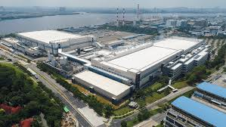

Company Background
Woodlands Fab 10X, 10N, 10A, 10W
Bendemeer Micron Semiconductor Backend (MSB)
5

Slide 6


Company Background
Bendemeer Micron Semiconductor Backend (MSB)
Departments
Test Engineering
Here
Quality Assurance
Manufacturing
…
6

Slide 7
Company Background
Bendemeer Micron Semiconductor Backend (MSB)
Test Engineering
Role:
Component Test Engineer
Responsibilities:
Assist Sr. Engineers
Perform Data Analysis
Improve Test Process
7

Slide 8
Project Background

Slide 9
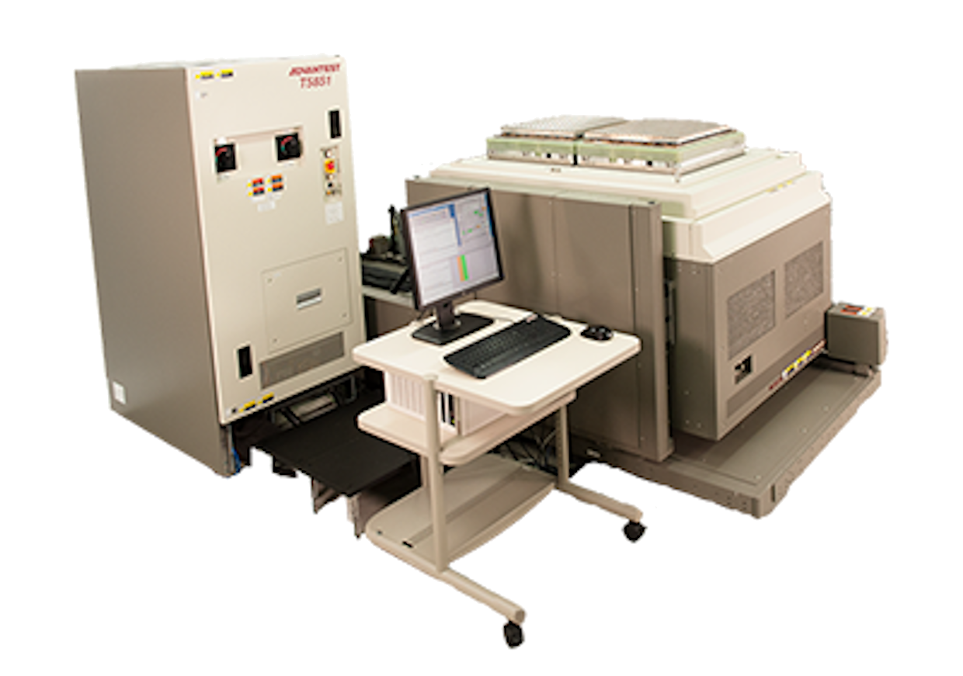

Project Background
How does testing work?
Pass/Fail
Units
Tester
Result
Problems
Can cause:
Increased Test Cost
Decreased Product Quality
Defective Parts sent to Customers
Many other issues!
9

Slide 10
Project Background
In more detail…
Problems
Goals
Steps Required
Test time too long
Reduce test time
Many things
Common point:
Solve hardware failures
Data Analysis
Hardware failures cause low yield (low pass rate for units)
Root cause analysis
10

Slide 11



Project Background
How do we perform data analysis?
Data Analysis
Gather Data
Perform Calculations
Visualize/Create Report
11

Slide 12
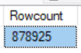
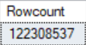
Project Background
In more detail (manual process)…
Still looks okay… but!
~
Impractical
Data needs to be gathered
hundreds/thousands of times
For a good analysis, many calculations needed
12

Slide 13
Project Background
Overall goal:
User to interpret visualizations
Done automatically
13

Slide 14
Project Background
How to automate data analysis?
Data Analysis
Gather Data
Perform Calculations
Visualize/Create Report
2 tools:
Python Script
Power BI
14

Slide 15
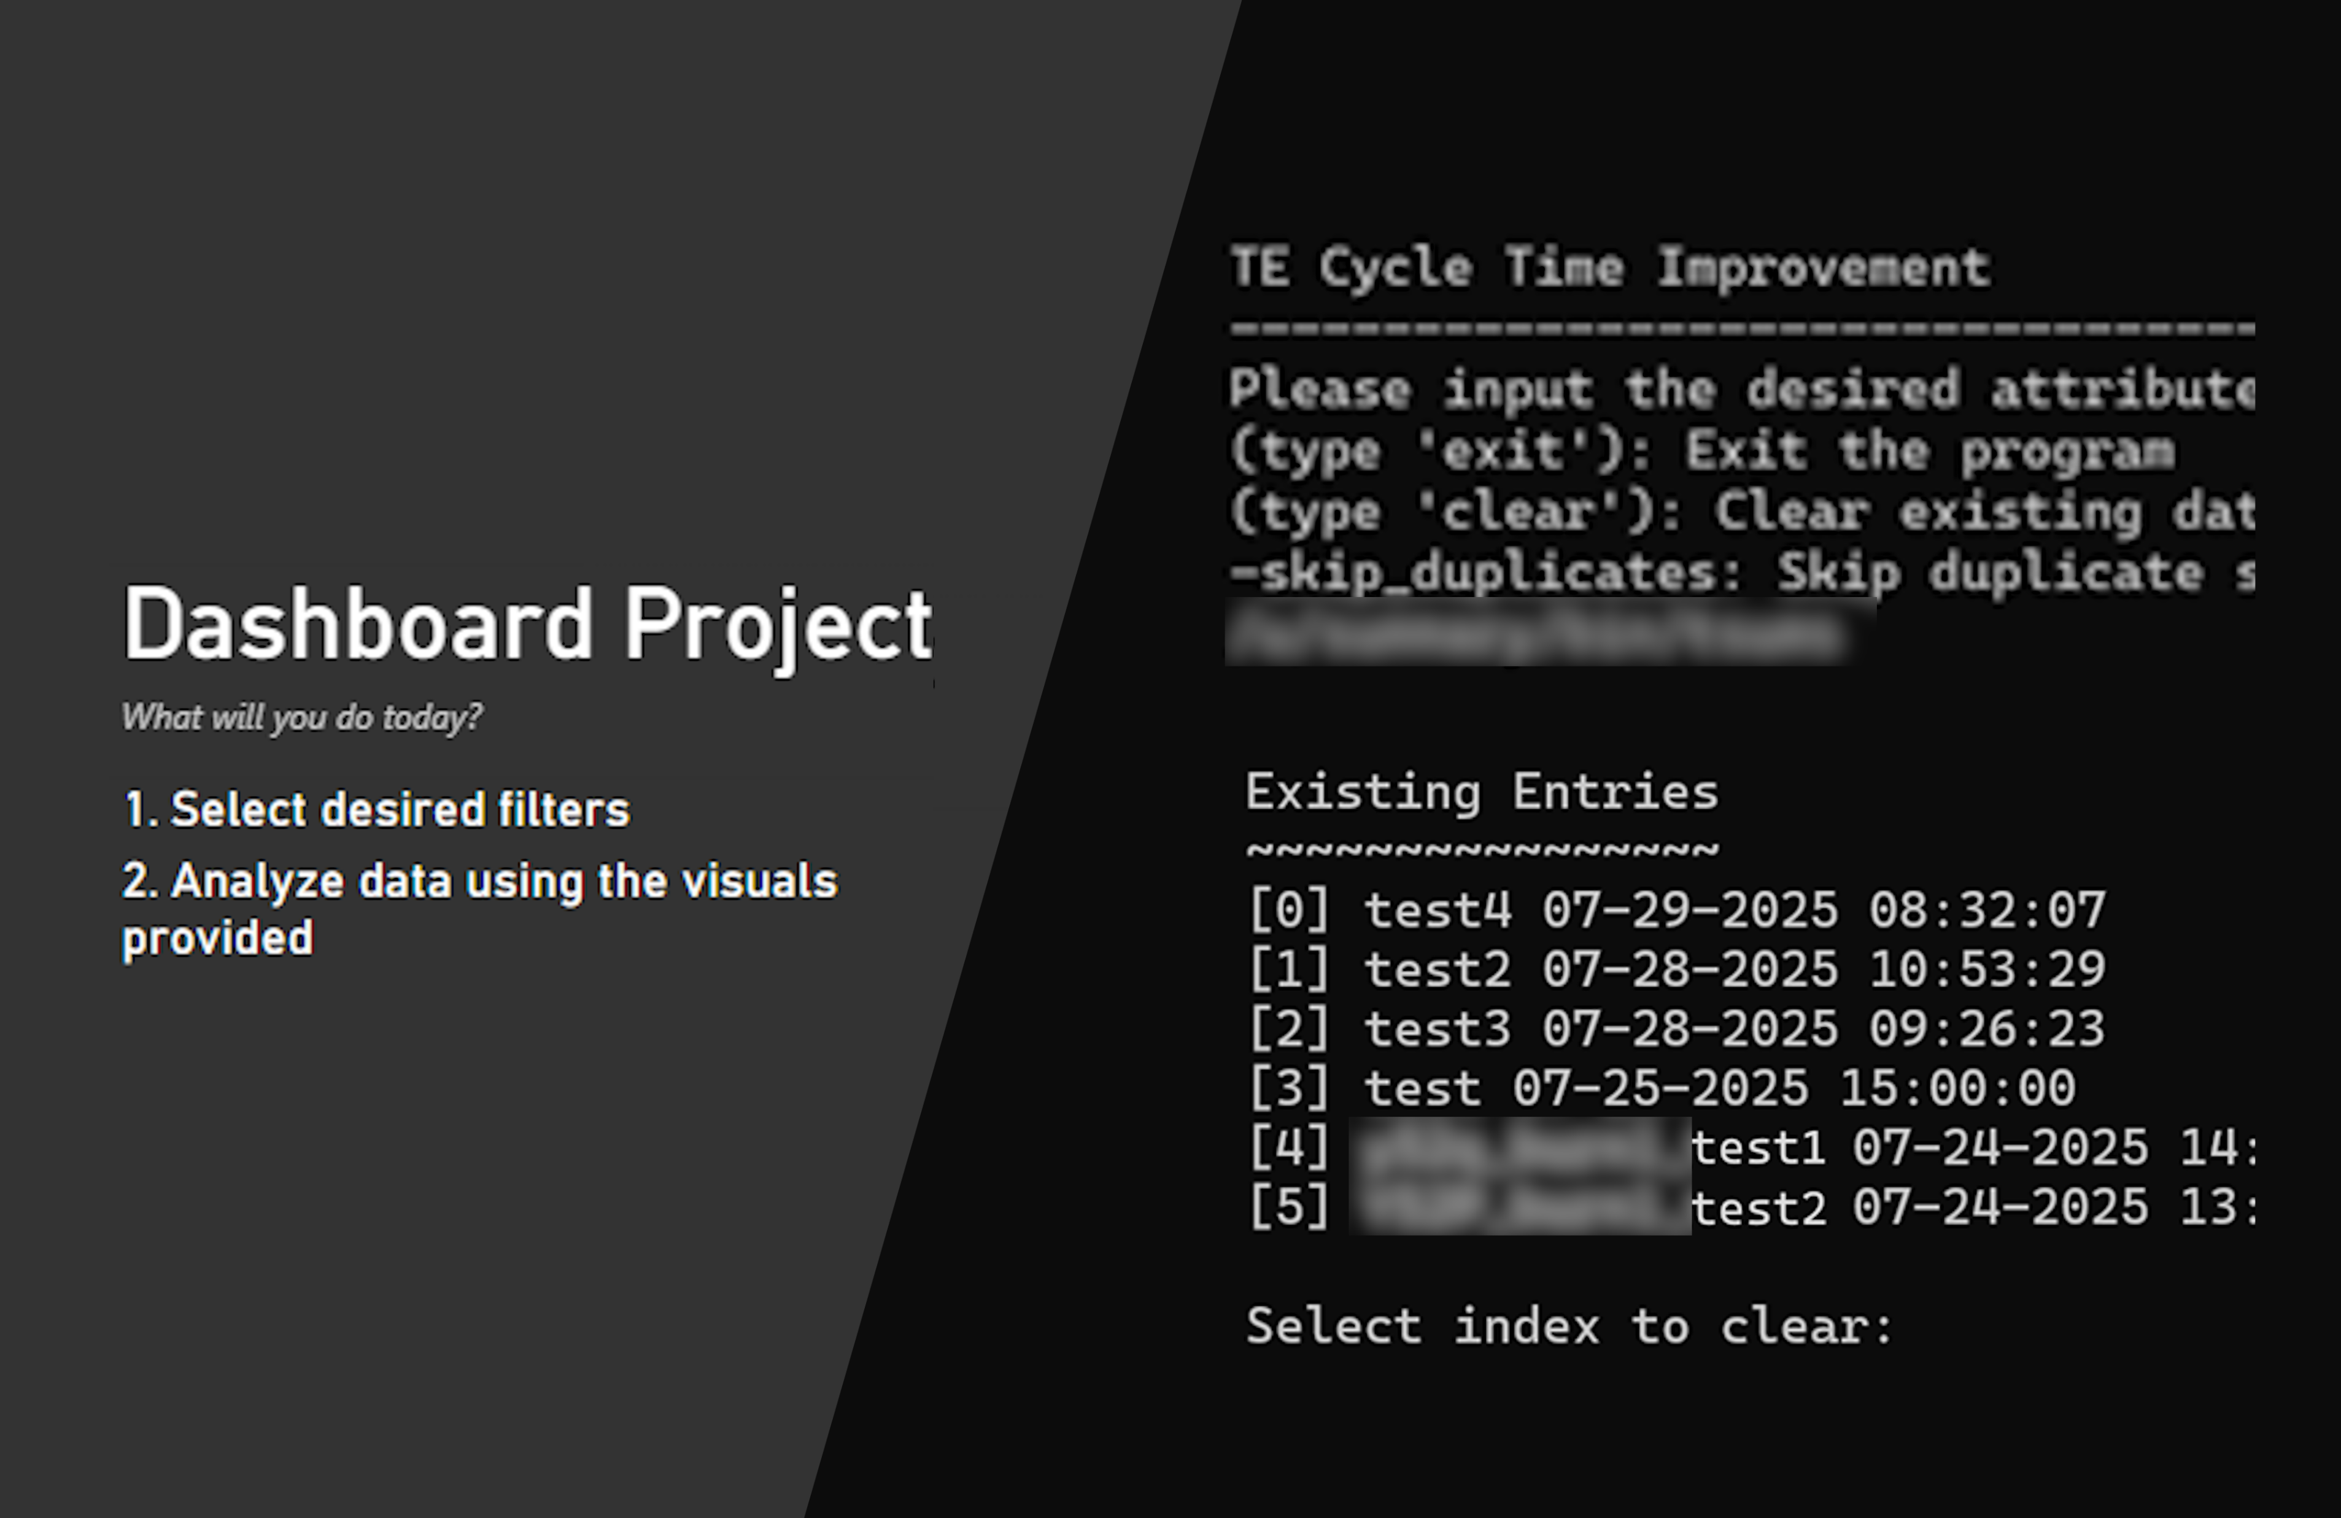
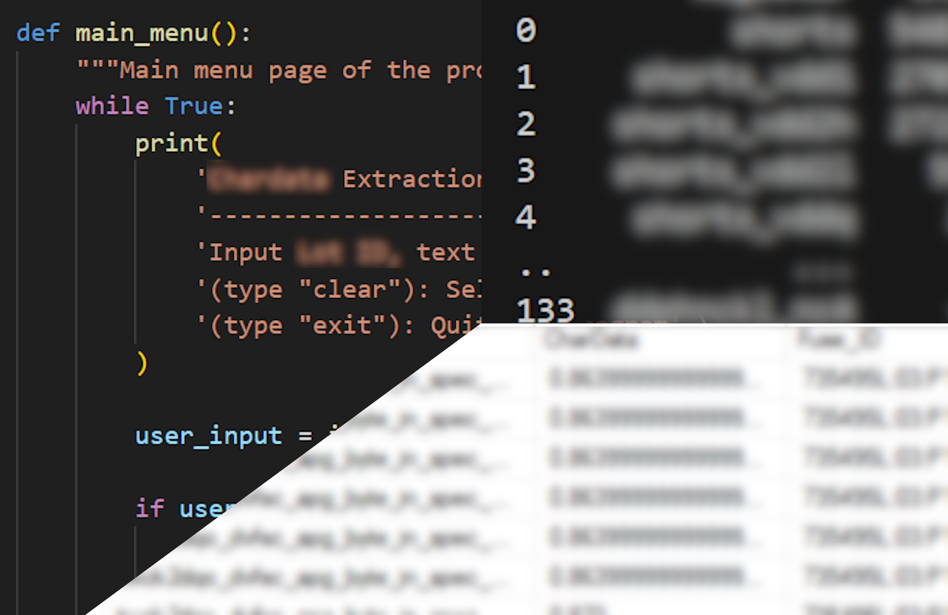
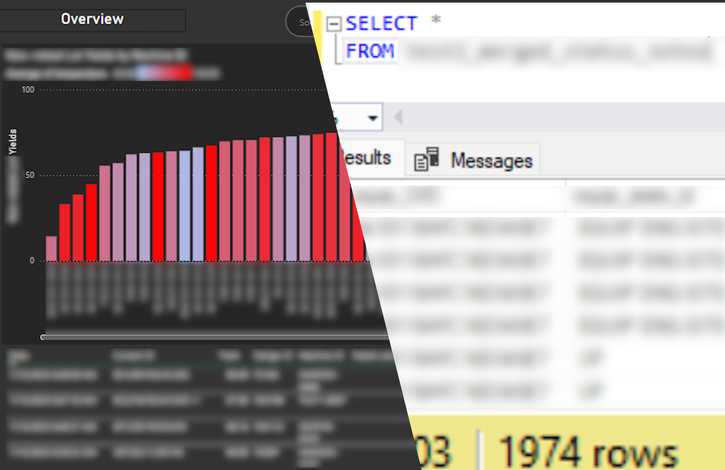
Projects
*: Unfinished project
Test Time Improvement
(early-mid April)
Root Cause Detection*
(mid July)
March 17
Aug 29
Hardware Failure Detection*
(late May)
15

Slide 16
Projects
Project:
Test Time Improvement
Problem Statement:
Test time may be too long
No tool for analysis exists
Objective:
Perform first-pass analysis
Show ways to reduce test time
Deliverables:
Python Script w/ UI UI allows user to choose specific data
Power BI Dashboard 7 pages for different analysis tasks
16

Slide 17
Projects
Project:
Test Time Improvement
Before | After
Days of time & effort to analyze | Processed automatically (1~3h)
Slow return of reports to stakeholders | Reports generated quickly
Complex analysis too impractical | Possible w/ automatic calculations
17

Slide 18
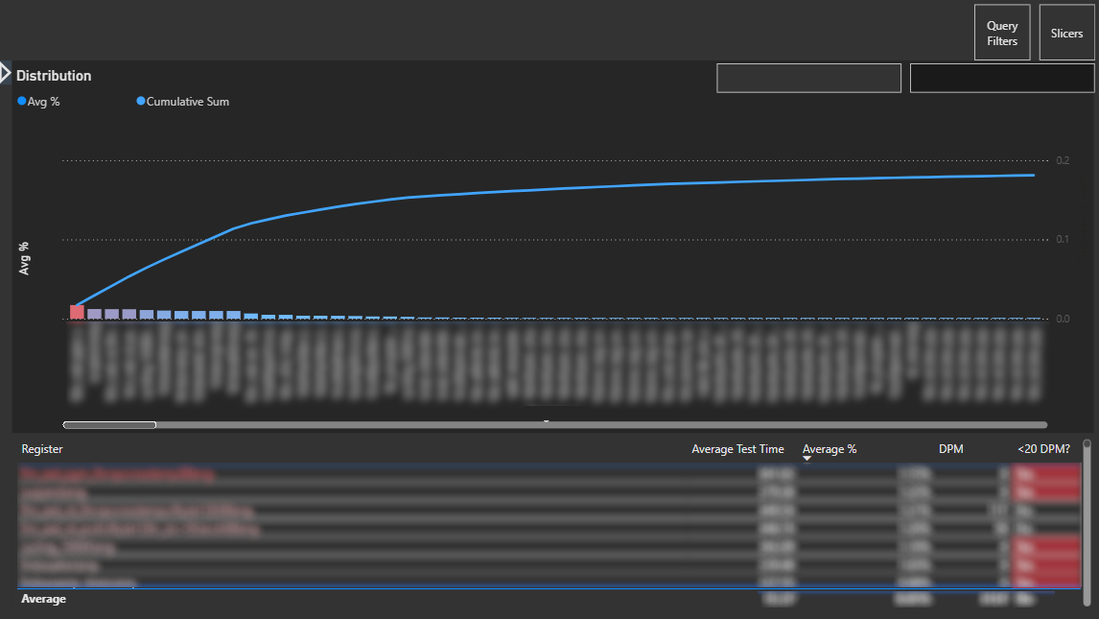
Projects
Dashboard Sample: Unnecessary Tests
Project:
Test Time Improvement
Using pareto chart:
Vital few (biggest contributors to test time)
Put these up for elimination
Pareto chart displaying average test time by test
18

Slide 19
Projects
Project:
Hardware Failure Detection
Deliverables:
Powershell Script to auto-run Python Script,
Python Script collect data send e-mail alerts
Power BI Dashboard 7 different pages display consolidated data
Problem Statement:
Need to watch for tester issues
Essential information is spread across different places
Objective:
Auto-detect potential issues
Consolidate important information
19

Slide 20
Projects
Project:
Hardware Failure Detection
Before | After
Disorganized; hard to understand | Intuitive design
Flags testers already under maintenance | Can check current tester status
Uncertain of effectiveness of maintenance | Track testers post-maintenance
20

Slide 21
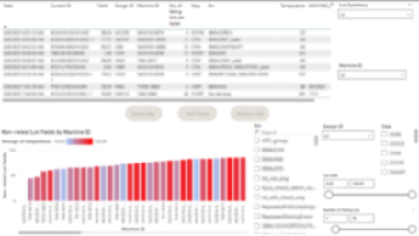
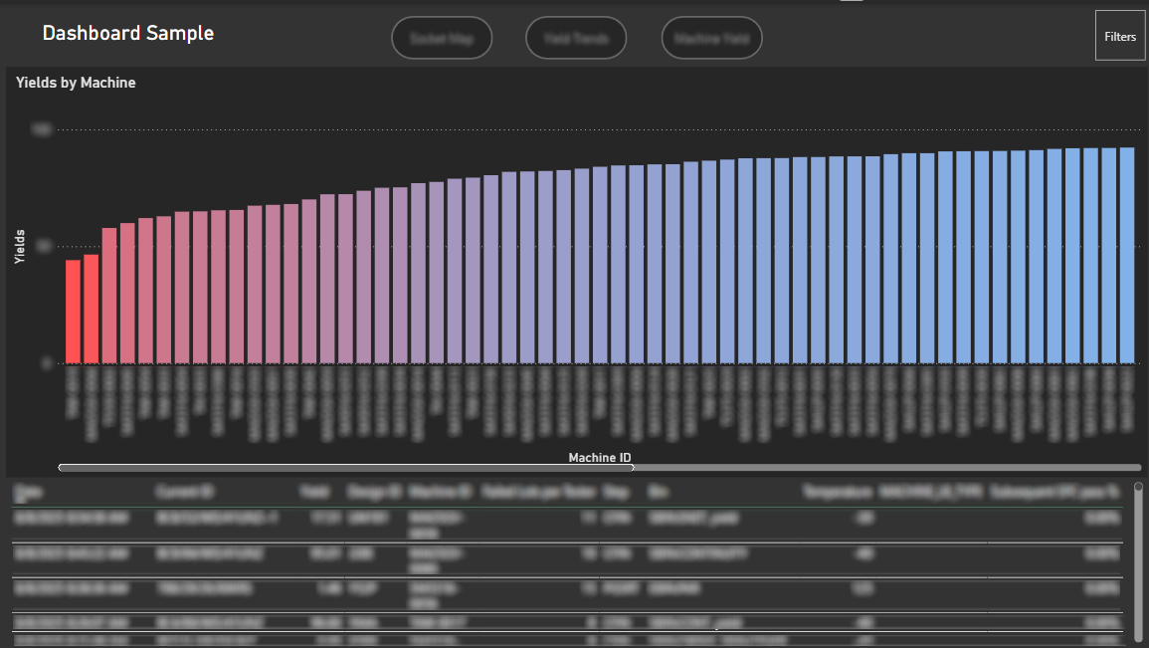
Tester yield excessively low:
Investigate
Old
Bar graph of Yield by Tester
21

Slide 22
Projects
Project:
Root Cause Detection
Problem Statement:
Need to know when an issue began;
Difficult to process data manually
Objective:
Find the start date of the issue
Automate the process
Deliverables:
Python Script with UI User can specify which tester logs to get data from
Power BI Dashboard ✕ Incomplete due to lack of time
22

Slide 23
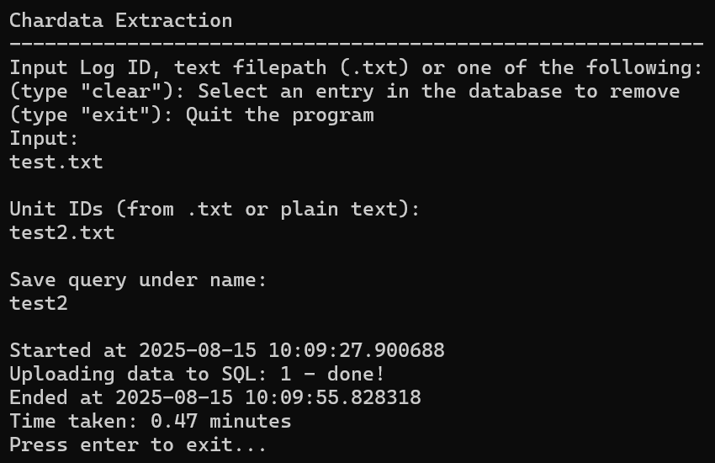
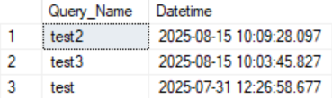
User Input
SQL Server Database
Data upload is done automatically: Much more efficient
Can be filtered for in future Power BI dashboard
23

Slide 24
Implementation

Slide 25
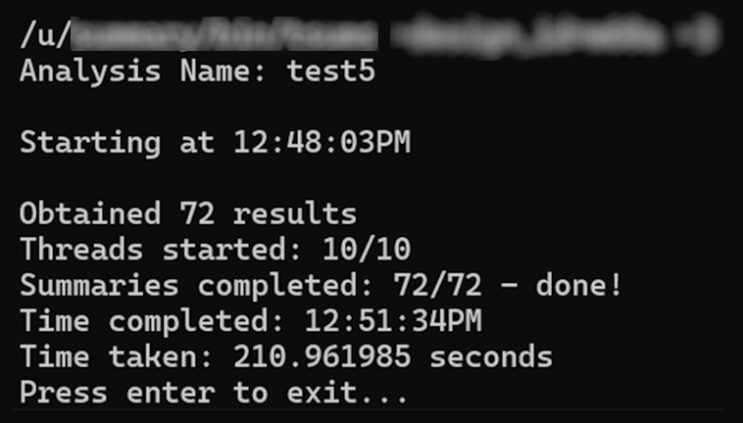
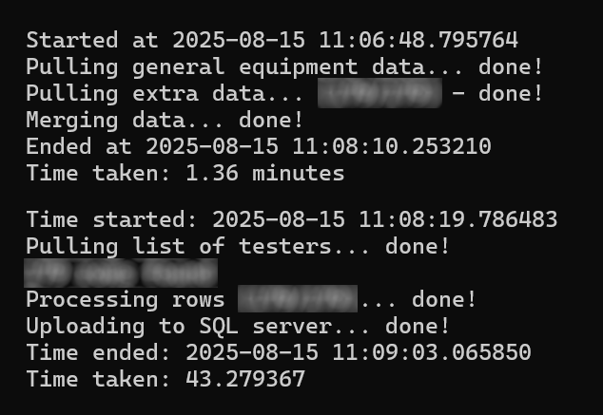
Implementation
To automate data analysis…
Python Scripts
Power BI Dashboard
How do these work together?
25

Slide 26
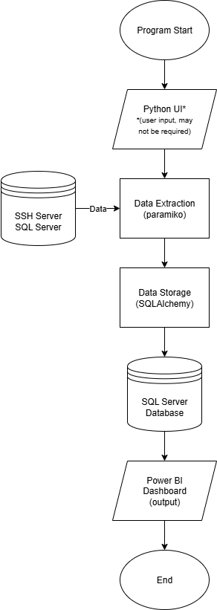
Implementation
Data Flow
Python Scripts
Power BI Dashboard
26

Slide 27
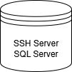
Implementation
Python Scripts
3 main tasks:
Python UI (depending on project) Allow user to adjust it to their needs
Data Extraction Pull data from database
Data Storage Store extracted data in SQL
SSH: Paramiko
SQL: SQLAlchemy
SQLAlchemy
27

Slide 28
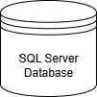
Implementation
SQL Server Database & Power BI Dashboard
SQL Server Database:
Stores data
Can be easily imported into Power BI
Power BI Dashboard
Transforms data
Performs various calculations
Visualizes data
Power Query
DAX
28

Slide 29
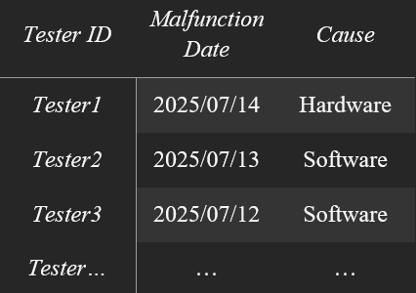
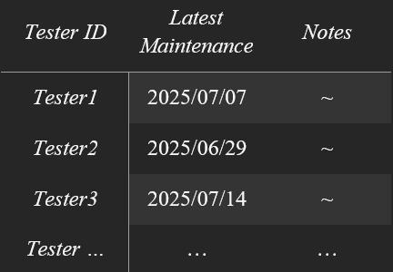
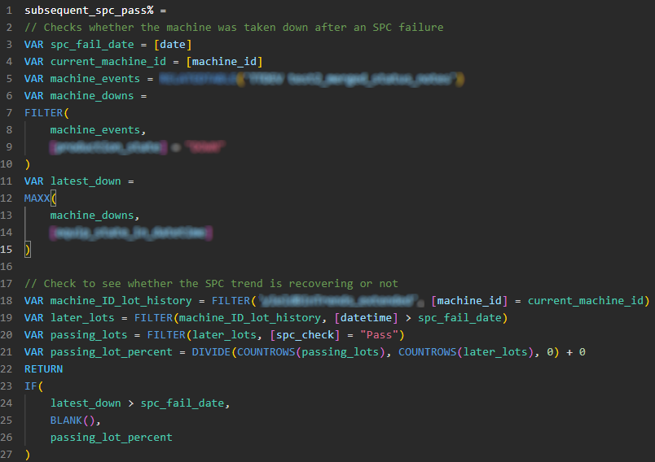
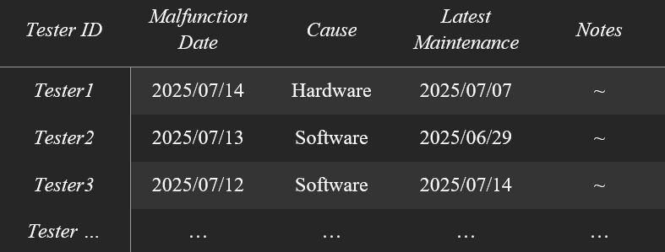
Implementation
SQL Server Database & Power BI Dashboard
: Short Explanation
Power Query
Power Query
Transforms data
DAX (Data Analysis Expressions) Perform complex calculations (similar to Excel formulas)
DAX
e.g. Joining Tables
e.g. Display the yield of a tester, only including units after the latest maintenance fix
29

Slide 30
Challenges

Slide 31
Challenges
3 things:
Main points:
Python
Time to Extract Data
Disconnections
Power BI
Time to Refresh
31

Slide 32
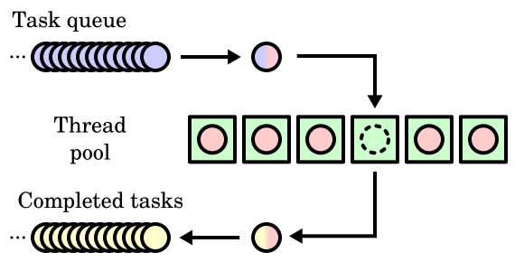
Challenges
3 things:
Problem
Solution
Python
Time to Extract Data
Disconnections
Power BI
Time to Refresh
Thread Pool:
Multiple “worker” threads pulling & uploading data
Slightly resource-intensive,
but very time-efficient
Although automated,
still huge
Takes time to extract
32

Slide 33
Challenges
3 things:
Problem
Solution
Python
Time to Extract Data
Disconnections
Power BI
Time to Refresh
Prevent:
Avoid triggering security measures (don’t overload server)
Mitigate:
Auto-reconnect function
Server security measures
Random issues
…
33

Slide 34
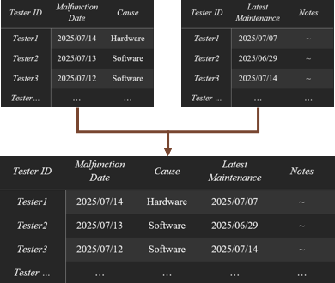
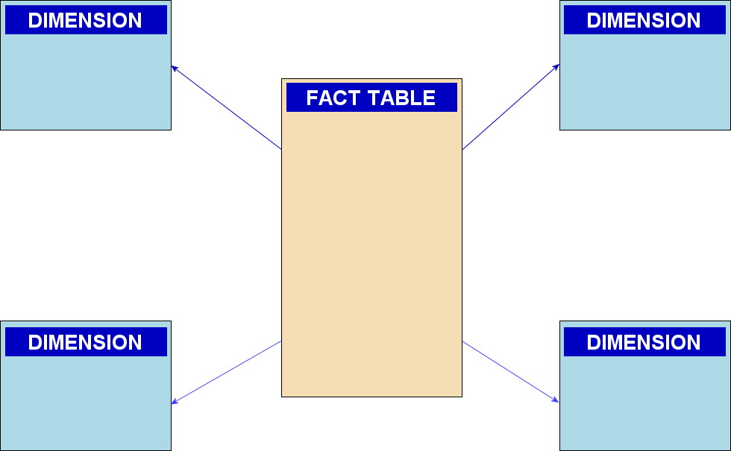

Challenges
3 things:
Problem
Solution
New data
Python
Time to Extract Data
Disconnections
Power BI
Time to Refresh
In Power BI:
Join tables in Power Query Optimize DAX calculations
Outside Power BI:
Utilize more suitable database structures (schemas)
*Required
Takes Time
34

Slide 35
Job/Technical Skills

Slide 36
Job/Technical Skills
Knowledge gained
Main points:
Python
SQL
Power BI
36

Slide 37
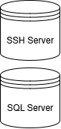
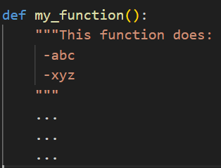
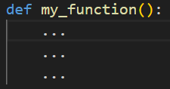
Job/Technical Skills
Elaboration
New Libraries:
paramiko, SQLAlchemy & threading
Code Documentation/ Styling
What does this do?
Python
SQL
Power BI
paramiko
SQLAlchemy
threading
Oh!
37

Slide 38
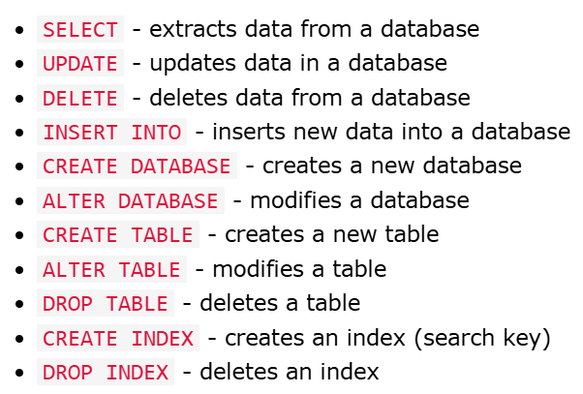
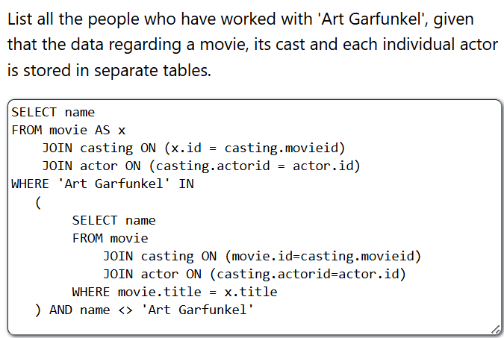
Job/Technical Skills
Elaboration
No Prior Experience
Self-learned:
Python
SQL
Power BI
Basic SQL operations
More complex queries
38

Slide 39
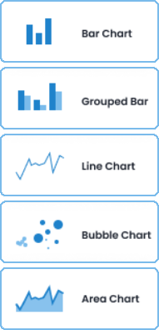
Job/Technical Skills
Elaboration
No Prior Experience
Self-learned:
Visuals
DAX
Python
SQL
Power BI
Complex Calculations
Core Concepts
Row context calculations row-by-row
Filter context calculations by many rows, grouped by filter
39

Slide 40
Workplace Diversity

Slide 41
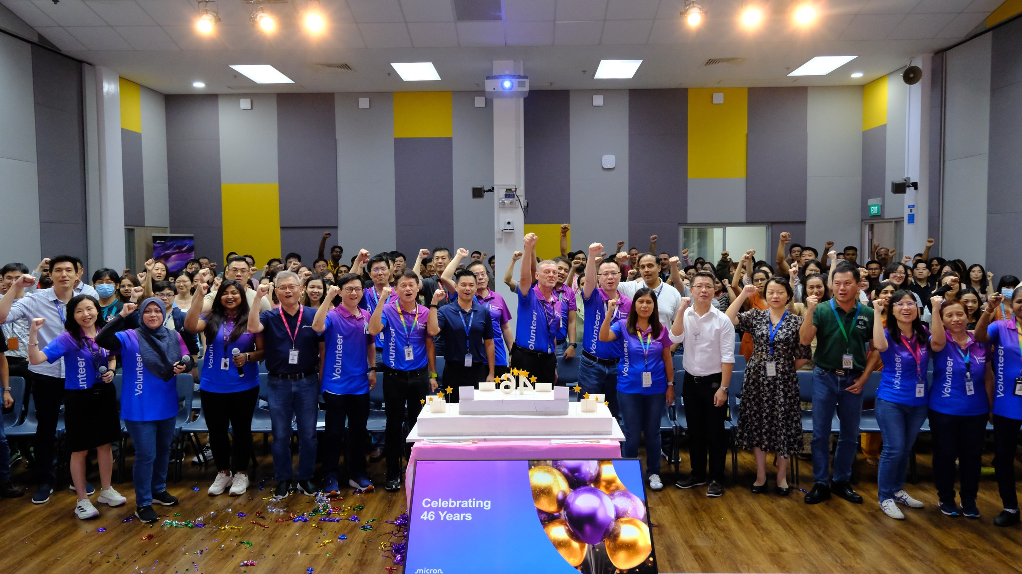
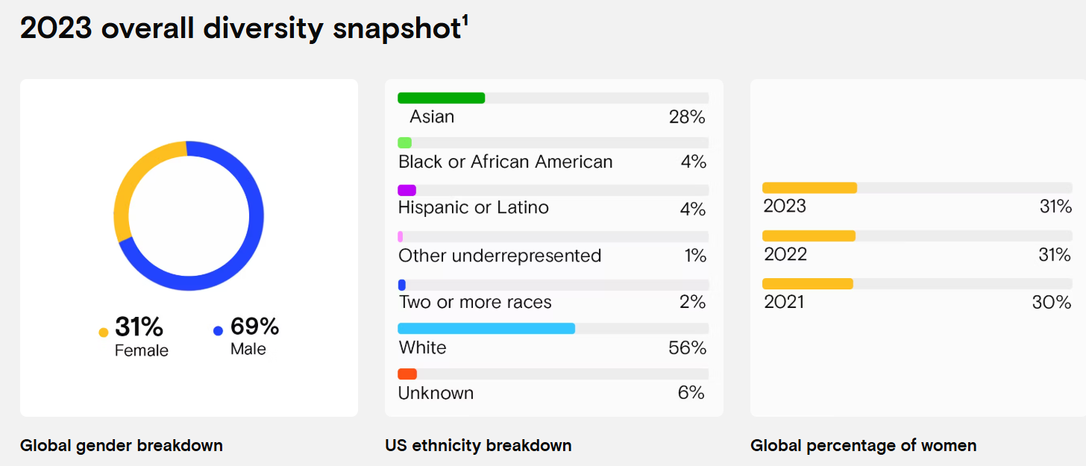
Workplace Diversity
Micron’s Values
Company Policy:
Emphasis on inclusivity
Anti-discrimination (“Equal Employment Opportunity”)
Support groups for minorities (Mosaic, Capable, etc.)
41

Slide 42
Workplace Diversity
“Micron Singapore believes that diversity and inclusion can breed more breakthrough innovative thinking.”
42

Slide 43
Conclusion

Slide 44

Conclusion
As an intern/employee…
Stay Curious
Always something new to learn
Upskill
Stay ahead of the competition
44

Slide 45

Conclusion
Above all…
Take Care
Be healthy, rest well
45

Slide 46

Thank you
Q&A

Slide 47
Project Background
How does testing work?
Problems
Pass/Fail
Units
Tester
Result
9

Slide 48
Projects
Project:
Root Cause Detection
Deliverables:
Python Script with UI UI allows user to specify data to pull
Power BI Dashboard Incomplete due to lack of time

Slide 49
Implementation
Python Scripts
Python UI (depending on project)
Uses simple Python “print” statements to display instructions
Simple if-statement logic
User Input

Slide 50
Implementation
Python Scripts
Data Extraction/Storage
Paramiko to get data from SSH
SQLAlchemy for data from SQL Database
SQLAlchemy to store data

Slide 51
Projects
Project:
Hardware Failure Detection
Deliverables:
Powershell Script to auto-run Python Script, send e-mail alerts
Python Script collect data
Power BI Dashboard 7 different pages display consolidated data

Slide 52
Projects
Project:
Test Time Improvement
Deliverables:
Python Script w/ UI UI allows user to choose specific data
Power BI Dashboard 7 pages for different analysis tasks

Slide 53
Projects
Project: Root Cause Detection
Context:
Deliverables:
Python Script
Power BI Dashboard
Intended Outcomes:
Notes:
Each tester has a list of measurements that they take for each unit

Slide 54
Projects
Project: Root Cause Detection
Context:
Units with specific defects
Tester with hardware issue
Since when?
Can be measured

Slide 55
Projects
Project: Root Cause Detection
Context:
Measurements
Unit 1: 0.3 Aug 03 Unit 2: 0.6 Aug 02 Unit 3: 0.5 Jul 27 Unit 4: 4.3 Jul 26 Unit 5: 0.3 Jul 23 Unit 6: 0.2 Jul 20 Unit 7: 5.2 Jul 16 Unit 8: 0.4 Jul 14 ... ...
Start of problem
Tester with hardware issue
Notes:
Each tester has a list of measurements that they take for each unit

Slide 56
Projects
Project: Root Cause Detection
Context:
Standardized procedure:
Gather Data
Perform Calculations
Create Report
Measurements
Unit 1: 0.3 Aug 03 Unit 2: 0.6 Aug 02 Unit 3: 0.5 Jul 27 Unit 4: 4.3 Jul 26 Unit 5: 0.3 Jul 23 Unit 6: 0.2 Jul 20 Unit 7: 5.2 Jul 16 Unit 8: 0.4 Jul 14 ... ...
Notes:
Each tester has a list of measurements that they take for each unit

Slide 57
Projects
Project: Root Cause Detection
Context:
However…
Measurements
Unit 1: 0.3 Aug 03 Unit 2: 0.6 Aug 02 Unit 3: 0.5 Jul 27 Unit 4: 4.3 Jul 26 Unit 5: 0.3 Jul 23 Unit 6: 0.2 Jul 20 Unit 7: 5.2 Jul 16 Unit 8: 0.4 Jul 14 ... ...
Measurements
Name Test 1 Test 2 Test 3 Test 4 ... Test 13241 Unit 1 0.34 0.44 0.31 0.78 ... 0.31 Unit 2 0.37 0.47 0.34 0.81 ... 0.33 Unit 3 0.36 0.43 0.32 0.82 ... 0.33 Unit 4 0.34 0.45 0.34 0.72 ... 0.32 Unit 5 0.33 0.44 0.33 0.77 ... 0.31 Unit 6 0.34 0.46 0.37 0.80 ... 0.30 ... ... ... ... ... ... ... Unit 1439 0.34 0.44 0.31 0.78 ... 0.29
Impractical to sift through manually!
Notes:
Each tester has a list of measurements that they take for each unit

Slide 58
Projects
Project: Root Cause Detection
Context:
Measurements
Name Test 1 Test 2 Test 3 Test 4 ... Test 13241 Unit 1 0.34 0.44 0.31 0.78 ... 0.31 Unit 2 0.37 0.47 0.34 0.81 ... 0.33 Unit 3 0.36 0.43 0.32 0.82 ... 0.33 Unit 4 0.34 0.45 0.34 0.72 ... 0.32 Unit 5 0.33 0.44 0.33 0.77 ... 0.31 Unit 6 0.34 0.46 0.37 0.80 ... 0.30 ... ... ... ... ... ... ... Unit 1439 0.34 0.44 0.31 0.78 ... 0.29
What can be done?
Sifts through the data automatically
Gather Data:
Python Script
Calculations & Report Creation:
Power BI
Notes:
Each tester has a list of measurements that they take for each unit

Slide 59
Projects
Project: Root Cause Detection
Context:
Sidenote
Gather Data:
Python Script
Calculations & Report Creation:
Power BI
Basis for all projects
(implementation discussed later)
Notes:
Each tester has a list of measurements that they take for each unit

Slide 60
Projects
Problem Statement (in general):
Issues may occur during the testing process.
These issues take a lot of time/manual effort to investigate and resolve.
Objective:
Improve the testing process more efficiently

